Slide 1

JBDL & CO WHOLESALERS CUSTOMER SEGMENTATION
1st July 2025

Slide 2

Introduction
Company Overview JBDL & Co Wholesalers serves a diverse clientele across the Horeca and Retail sectors, providing essential goods such as Fresh Produce, Dairy, Groceries, Frozen Items, and Detergents.
Industry Relevance In the evolving wholesale landscape, data-driven decision-making is key. Understanding spending behavior helps tailor services, reduce costs, and boost customer satisfaction.
Objective of the Analysis To segment wholesale customers of JBDL & Co Wholesalers based on their annual spending patterns using K-Means Clustering. These insights will guide strategic decisions and personalized marketing to serve each customer group better.

Slide 3

Problem Statement
Business Problem JBDL & Co Wholesalers currently applies a one-size-fits-all approach to marketing and customer service, which fails to address the unique needs of different customer types. This limits growth and reduces customer retention.
Analytical Goal Applying K-Means clustering to discover distinct customer segments based on product category spending. Identify behavioral patterns that can inform targeted business strategies.
Key Task Determining the optimal number of customer segments, analyzing cluster characteristics, and assigning tailored strategies to each group for better engagement and profitability.

Slide 4

DATASET OVERVIEW
Summary Statistics
Variable | Description | Data Type
Channel | Customer type (1 = Horeca, 2 = Retail) | Integer
Region | Customer's region (1 = Lisbon, 2 = Oporto, 3 = Other) | Integer
Fresh | Annual spending on fresh produce | Integer
Milk | Annual spending on milk products | Integer
Grocery | Annual spending on grocery items | Integer
Frozen | Annual spending on frozen products | Integer
Detergents_Paper | Annual spending on detergents and paper products | Integer
Delicassen | Annual spending on delicatessen items | Integer
Data Snapshot
Data source
UCI Machine Learning Repository
Total number of records
440
Missing values
0
Duplicates
0
Data types
Numerical (integer) data types

Slide 5
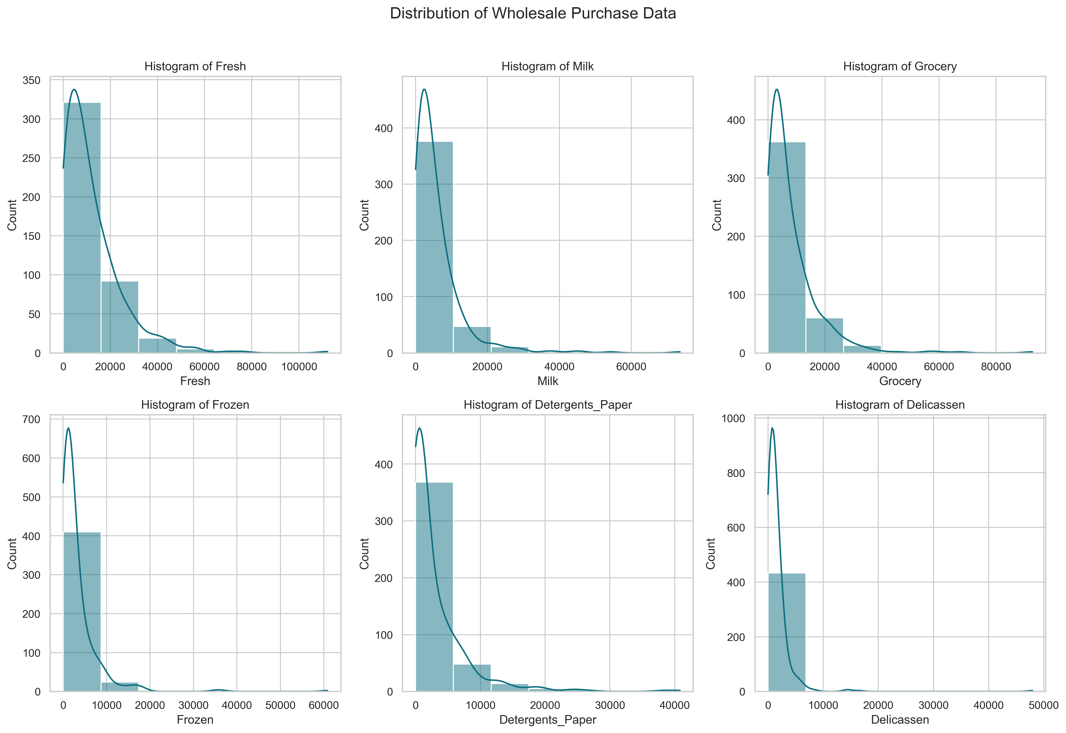
EXPLORATORY DATA ANALYSIS: Feature Distribution (Histograms)
Most features such as Fresh, Milk, Grocery, Frozen, Detergents_Paper, and Delicatessen show right-skewed distributions.
Most of the customers have low to moderate annual spending, with a few being high spenders.
There is an evidence of long tails, which suggests the presence of many outliers.
These patterns emphasize the importance of normalization and outlier treatment before applying clustering algorithms.

Slide 6
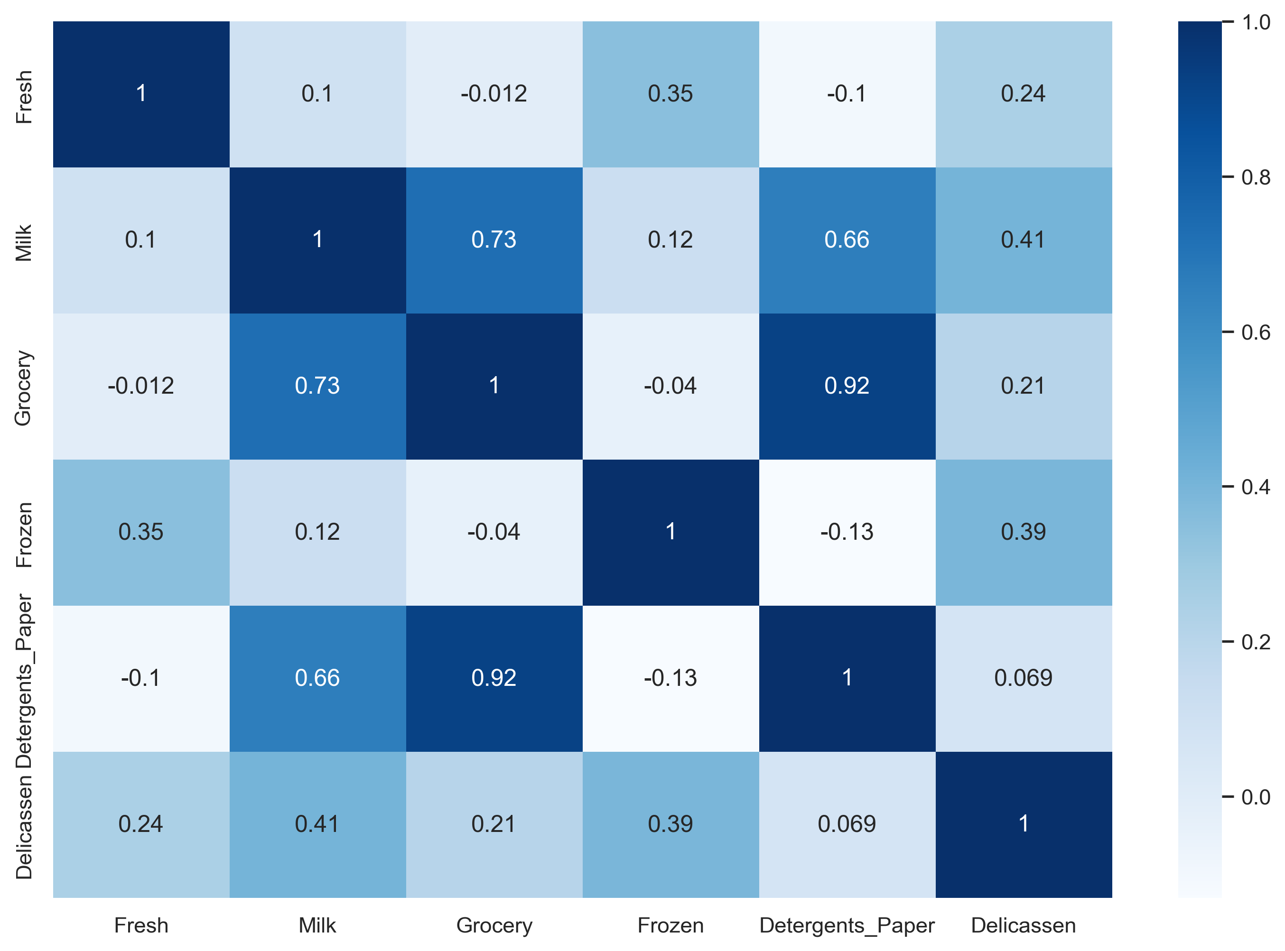
Features Correlation Heatmap
Strong Correlations
Grocery & Detergents_Paper, Milk & Grocery, and Milk & Detergents_Paper all show strong correlations with coefficients of 0.92, 0.73, and 0.66, respectively.
Weak/Negative Correlations
Fresh and Frozen show little correlation with all the other categories, showcasing both weak positive and weak negative correlations.
Insights
Customers who buy groceries are likely to buy Detergents_Paper and Milk, suggesting bundled promotions.
Fresh and Frozen are independent of other categories, possibly representing unique customer needs (e.g., restaurants vs. convenience stores).

Slide 7
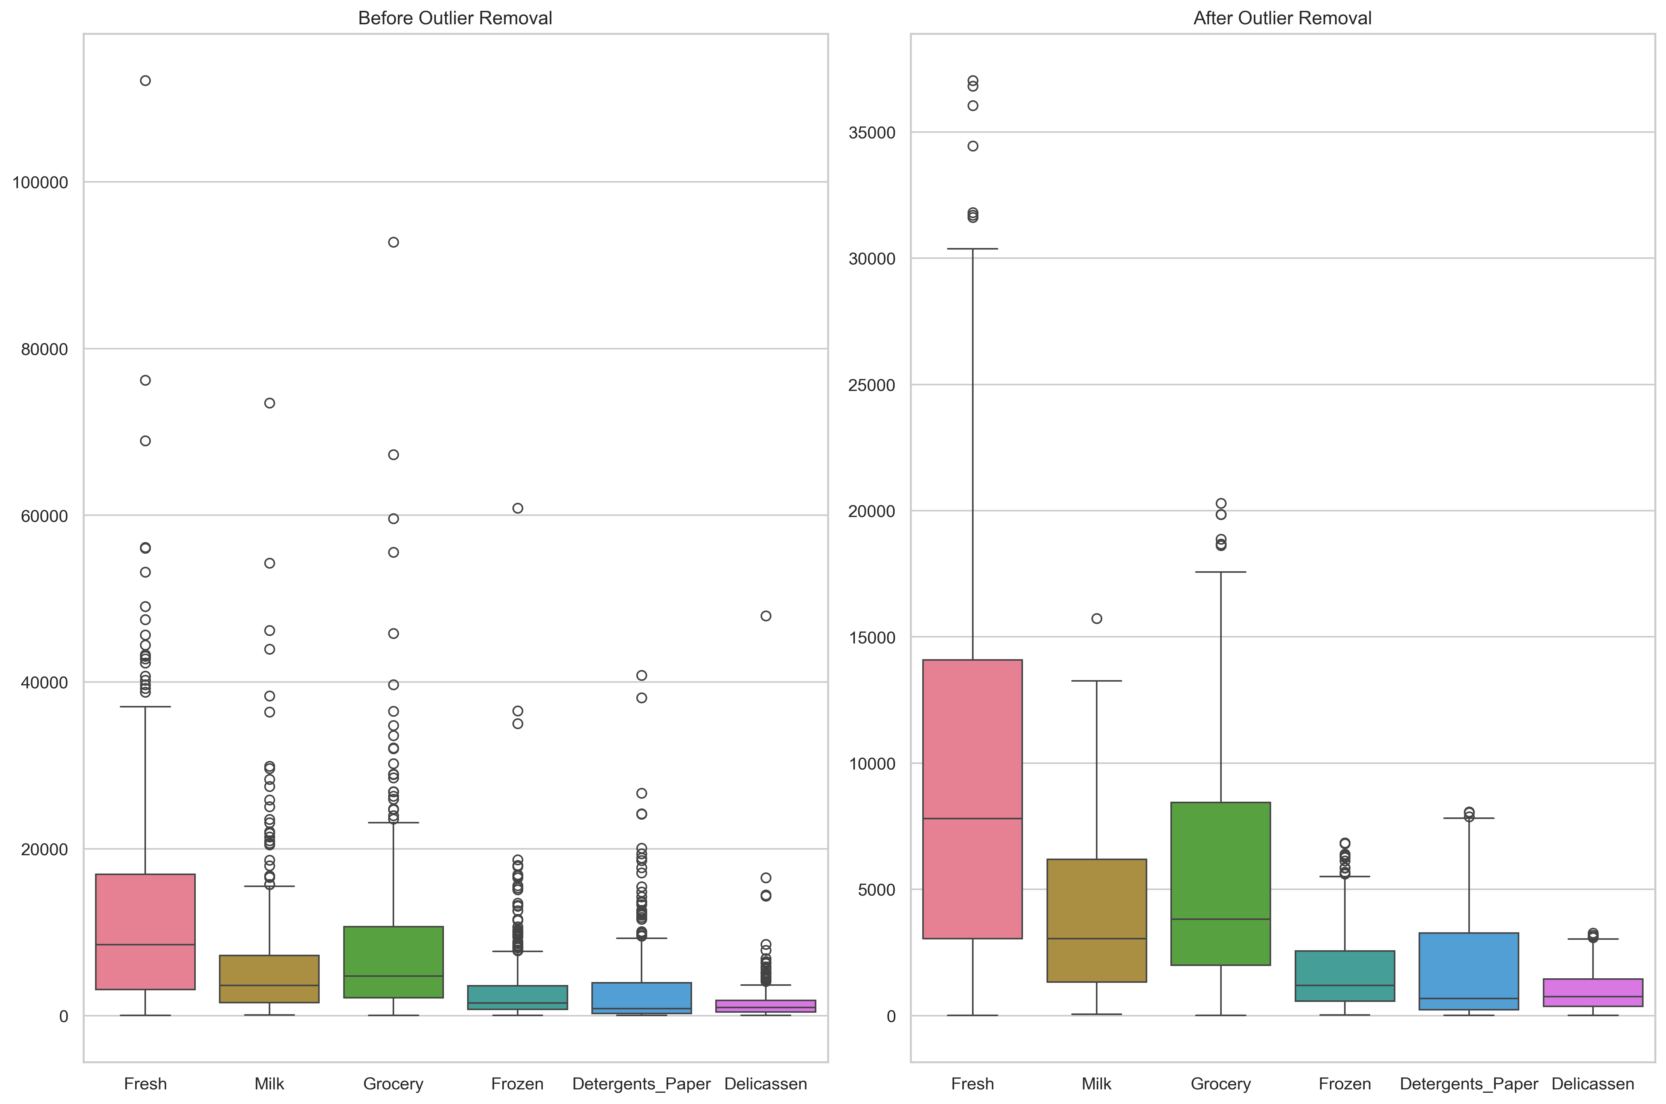
Features Before & After Outlier Removal (Boxplots)
Before outlier removal:
Huge outliers in all categories, especially Fresh and Grocery.
Outliers distort mean-based analysis and clustering.
After outlier removal:
The distributions become more compact, representative, and balanced.
Cleaner data is now suitable for clustering techniques like KMeans.
Removing outliers significantly improves data quality for machine learning. This step reduces skewness and ensures more reliable cluster separation.

Slide 8
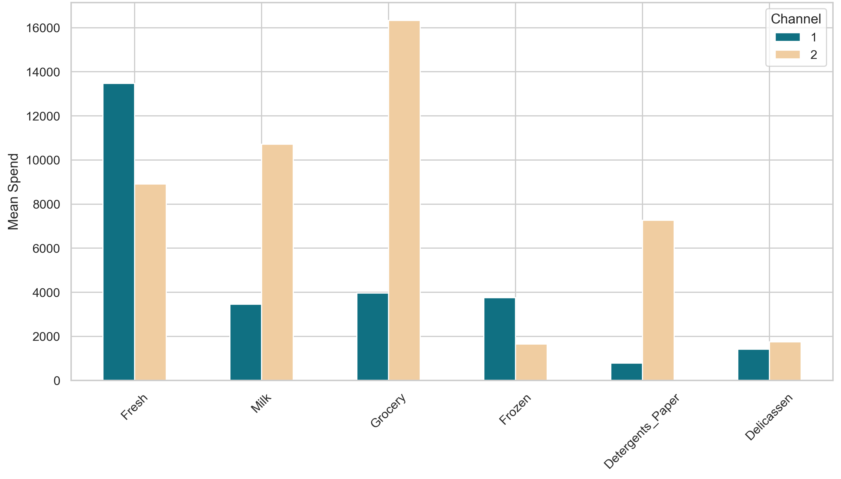
Category Spending Patterns by Channel
Channel 1 (Horeca) focuses more on perishable food items, while Channel 2 (Retail) leads in non-perishables and packaged goods.
Product Category | Channel 1 (Horeca) | Channel 2 (Retail) | Insight Summary
Fresh | Very high | Moderate | Horeca heavily buys fresh produce (e.g., hotels/restaurants).
Milk | Low | High | Retailers purchase more milk than Horeca.
Grocery | Moderate | Very high | Retail has the highest grocery expenditure.
Frozen | Moderate | Low | Horeca prefers frozen items more than retail.
Detergents_Paper | Low | High | Retailers stock more cleaning supplies.
Delicatessen | Slightly lower | Slightly higher | Retail leads slightly in delicatessen spending.

Slide 9
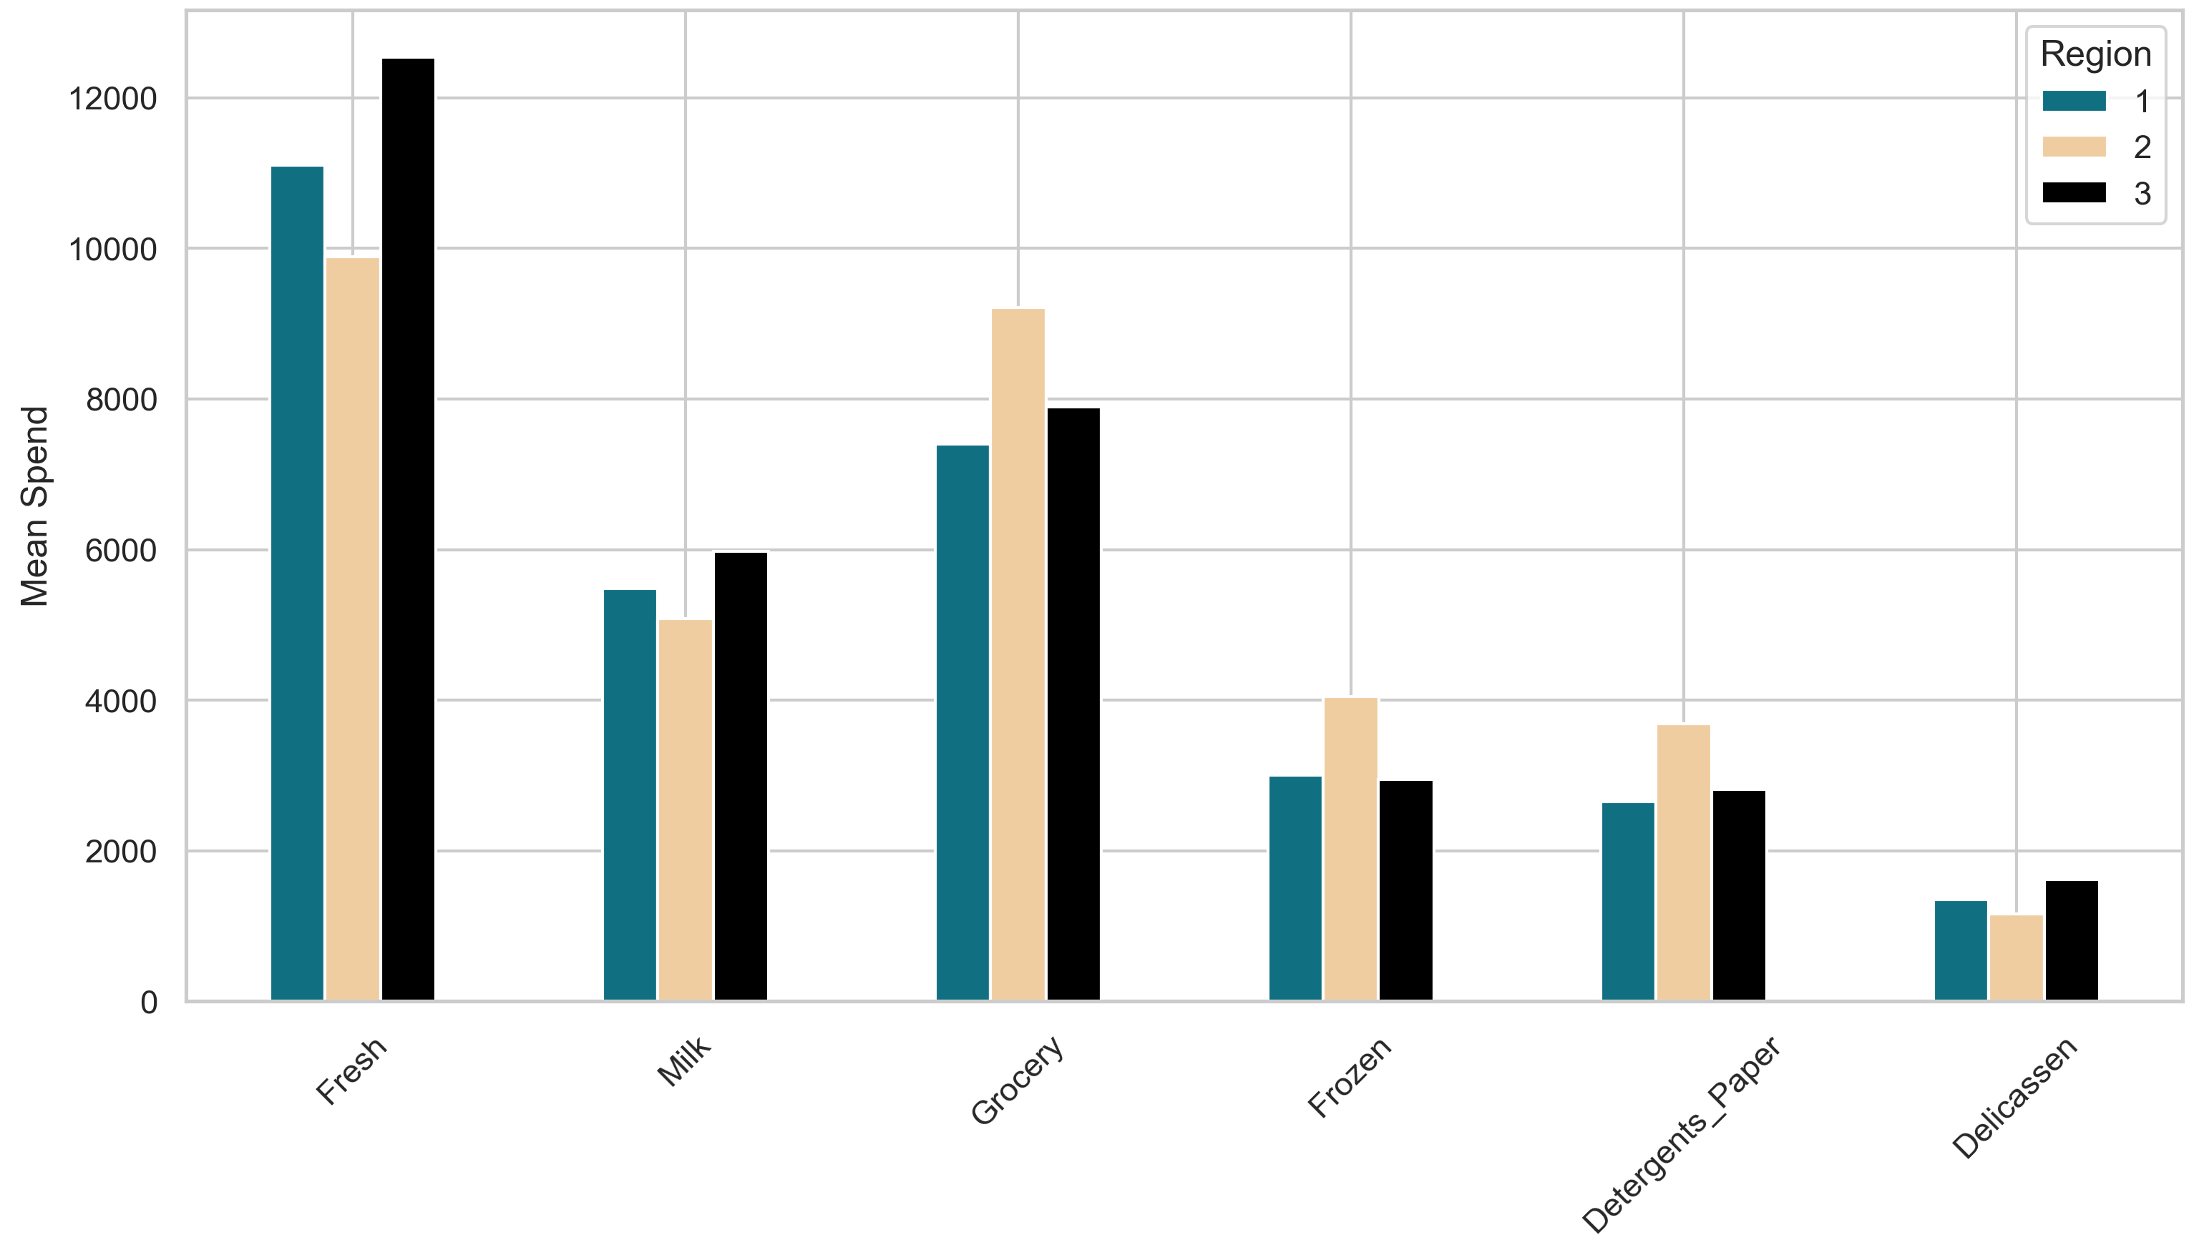

Average Spending by Region Key Observations:
Region 3 leads in spending, especially in Grocery, Milk, and Fresh.
Lisbon and Oporto show moderate but similar spending, lower than Region 3.
Fresh and Grocery are top categories across all regions.
Frozen, Detergents_Paper, and Delicassen have the lowest spending, suggesting niche demand.

Slide 10
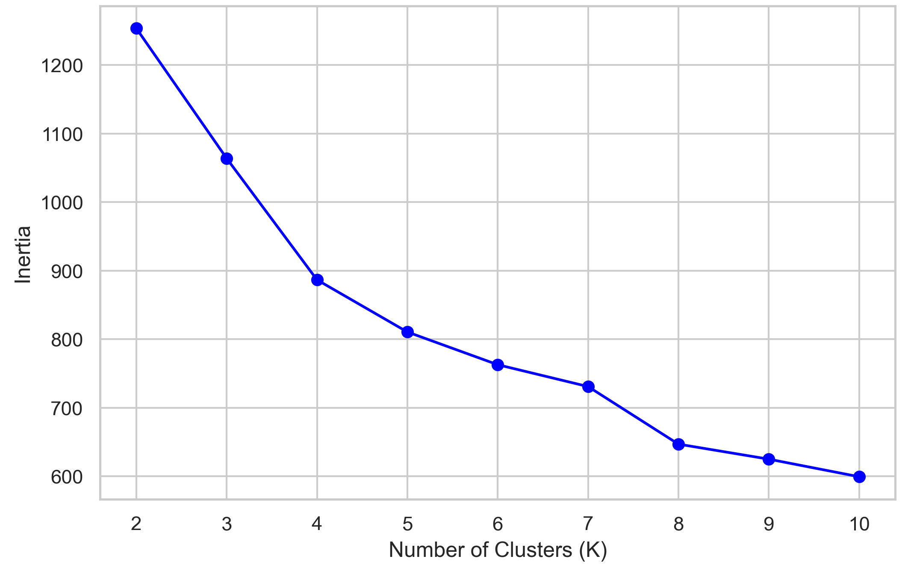

Determining Optimal K Using Inertia
Key Observations
Inertia drops as K increases, but the decline slows after K = 4 to 5.
A subtle elbow appears around K = 4, indicating diminishing returns.
Interpretation
K = 2 to K = 4 implies meaningful gains in cluster separation.
Beyond K = 4 mean minimal improvement; potential for overfitting.
Business Insight
K = 4 is optimal as it balances clarity and complexity.
More clusters (K > 4 ) may not yield useful segmentation.
Caution
The elbow method is subjective; thus, it’s better to combine it with silhouette scores for better validation.

Slide 11
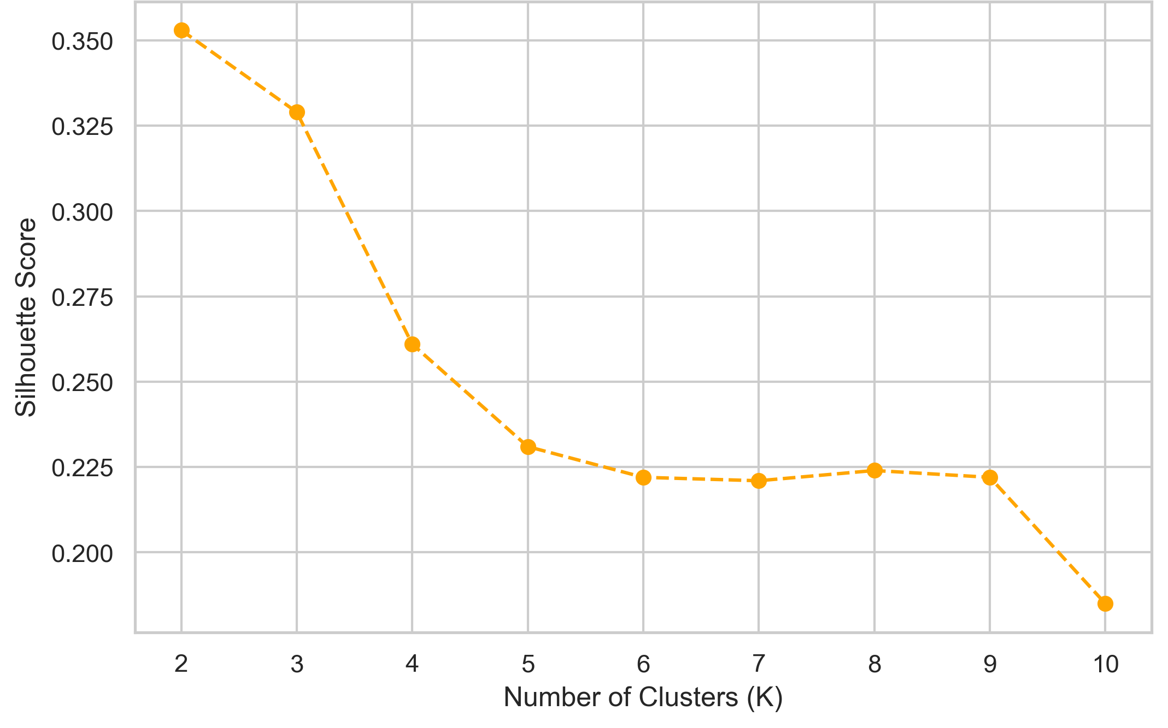

Validating Cluster Quality Using Silhouette Score
Key Observations
Highest score (0.35) at K = 2 gives the best cluster separation.
Gradual decline from K = 3 to K = 10, with a noticeable drop after K = 4.
Interpretation
K = 2 is the strongest statistical separation, ideal for broad segmentation.
K = 4 is slightly lower (0.30) but still acceptable for detailed segmentation.
K > 4, the scores fall below 0.30, suggesting overlapping clusters.
Business Insight
Use K = 2 for simple, high-level grouping (e.g., Retail vs. Horeca).
Use K = 4 for actionable sub-segments (e.g., large vs. small clients).
Avoid K > 4 due to the risk of unclear or impractical segments.

Slide 12

METHODOLOGY: Clustering Approach
Core Technique - KMeans Clustering
Goal - Segment customers based on their annual purchasing patterns.
Why K-Means?
- It’s efficient for large datasets.
- It captures spending behavior patterns based on Euclidean distance.
Techniques Employed
K-Means Clustering
Divides customers into K groups based on similarity in spending.
Elbow Method
Helped identify the optimal number of clusters by analyzing Within-Cluster Sum of Squares (WCSS).
K=4 identified as an optimal balance between complexity and clarity.
Silhouette Score
Used for validating the cohesion and separation of clusters.

Slide 13
METHODOLOGY: Data Preparation
Data Cleaning
No missing values in dataset (all 440 entries complete).
Columns “Channel” and “Region” handled based on modeling needs:
- Retained for EDA & segment interpretation.
- Dropped for pure clustering model.
Feature Scaling
Used StandardScaler to:
- Normalize features to mean = 0, std = 1.
- Ensure fair weight in distance-based clustering.
Selected Features for Modeling
Feature | Description
Fresh | Annual spend on fresh products
Milk | Annual spend on milk products
Grocery | Annual spend on grocery items
Frozen | Annual spend on frozen items
Detergents_Paper | Annual spend on cleaning supplies
Delicassen | Annual spend on delicatessen products

Slide 14

METHODOLOGY: Modeling Execution
Train-Test Split
Not used in this unsupervised learning task.
The entire dataset was used for clustering and pattern discovery.
Dimensionality Reduction (Visualization Only)
Applied Principal Component Analysis (PCA):
- Reduced dimensions to 2D for visual interpretation.
- Allowed clearer visualization of cluster separation in plots.
Modeling Steps Summary
Scaled selected features.
Ran K-Means for K = 2 to 10.
Evaluated using Inertia & Silhouette Scores.
Visualized clusters with PCA and pairplots.
Labeled data with cluster assignments for profiling.

Slide 15

MODELING & EVALUATION: Metrics and Performance
Model Performance Evaluation
1. Within-Cluster Sum of Squares (WCSS / Inertia)
Measures cluster compactness, and lower values imply tighter groupings.
Significant drop observed from K = 2 to K = 4, justifying further segmentation up to K = 4.
The elbow is at K = 4, the point beyond which additional clusters add little value.
2. Silhouette Score
Measures separation and cohesion (range: -1 to 1).
K = 2 yields the highest silhouette score (0.35) - strongest separation.
K = 4 produces a slightly lower but still acceptable score (0.30), enabling granular segmentation.
K > 4 results in score degradation, and clusters begin to overlap.
Conclusion
K = 2 is statistically optimal.
K = 4 is business-relevant with interpretable sub-groups.

Slide 16
MODELING & EVALUATION: Cluster Interpretation
Cluster Profiles (K = 4 Model Chosen)
Cluster | Key Spending Behavior | Likely Customer Type
Cluster 0 | High Fresh & Frozen, low Detergents_Paper | Restaurants / Horeca
Cluster 1 | High Milk, Grocery, Detergents_Paper | Retailers / Supermarkets
Cluster 2 | Low spending across all product categories | Small buyers / Infrequent users
Cluster 3 | Balanced spending, no extreme category dominance | Local cafes / general customers
Cluster Profiles (K = 4 Model Chosen) - Interpretation Summary
Cluster 0 (Horeca):
- Prioritize fresh ingredients and frozen inventory.
- Likely smaller in volume but higher variability in orders.
- Need for flexibility and seasonal promotions.
Cluster 1 (Retail):
- Consistent purchases of staple goods and cleaning supplies.
- Likely larger volume, repetitive purchases.
- Ideal for bulk sales, bundling, and contract deals.
Visual Insights
Pair Plots
Showed clear separation between clusters in high-variance dimensions.
Reinforced correlations (e.g., Grocery ↔ Detergents_Paper).
Cluster Distribution
Bar plot revealed customer count per cluster.
Cluster 1 (Retail) had the highest population, indicating a strong retail presence.
Cluster 2 had the fewest likely niche or under-engaged customers.
Interpretation
Each cluster offers a unique business opportunity.
Enables targeted strategy design per segment (covered in Slides 17–18).

Slide 17
RESULTS AND INSIGHTS
Business Interpretation
Key Findings
1. Targeted Marketing
Retailers (Cluster 1):
- Offer bulk or bundled discounts on Grocery + Detergents_Paper.
- Use subscription models for steady revenue.
Horeca (Cluster 0):
- Promote seasonal Fresh produce & Frozen bundles.
- Offer bundle campaigns with kitchen supplies.
2. Inventory Management
Align product stock with dominant cluster demand:
- Stock up Fresh & Frozen for Horeca-heavy regions.
- Expand Grocery & Paper supplies for retail-dense areas.
Customers form 3 - 4 distinct segments based on annual product spending patterns.
Clear behavioral differences:
- Cluster 1: High spenders on Grocery and Detergents_Paper - likely Retailers.
Cluster 0: Higher spending on Fresh and Frozen - likely Restaurants/Horeca.
Clusters show distinct purchasing behavior, justifying targeted marketing.

Slide 18


RECOMMENDATIONS
3. Clustering Model Recommendations
Use K = 4 when granular segmentation is required for diverse campaigns.
Use K = 2 when simplicity and efficiency are key - great for broad strategy (Retail vs. Horeca).
1. Personalized Promotions
Retail (Cluster 1 / High Grocery & Detergents_Paper)
- Offer bulk discounts on Grocery + Detergents_Paper.
- Introduce subscription models for recurring retail orders.
- Example: "Buy Grocery & Detergents in bulk, save 10% monthly."
Horeca Segment (Cluster 0 or Cluster 3 / High Fresh & Frozen)
- Bundle Fresh + Frozen goods tailored for meal prep.
- Partner with local farms for cost-effective seasonal supply.
- Example: "Order Fresh + Frozen package, get next-day delivery free."
4. Supply Chain Optimization
Align inventory and logistics with dominant segment needs:
- High volume for Region 3.
- Diverse smaller packages for Lisbon/Oporto.
Prioritize Fresh & Grocery sourcing during peak Horeca seasons.
2. Customer Retention
Low-Engagement Customers (Cluster 4 or Cluster 2)
-Launch loyalty programs to incentivize regular purchases.
- Run limited-time win-back campaigns.
- Example: "Spend KSh 20,000 this month, earn KSh 1,500 in credits."
Small Retailers or Cafes (Balanced Spending Clusters)
- Offer multi-category bundles (e.g., Milk + Delicatessen).
- Personalized reminders on reordering cycles.
5. Region-Specific Marketing
Region 3 (High-Value Customers)
- Target bulk promotions (Grocery/Milk/Detergents_Paper).
- Bundle cross-sell offers (e.g., “Stock up on Grocery + Paper, save 10%”).
Lisbon & Oporto (Moderate Spending)
- Promote Fresh Produce Campaigns (e.g., “Lisbon Fresh Week”).
- Upsell Frozen or Delicatessen via themed bundles.

Slide 19

CONCLUSION
Recap
Problem - Identified customer segments to optimize sales strategies.
Approach - Used K-Means clustering on purchasing data.
Key Takeaway - Clear customer segments exist, enabling data-driven decision-making.
Final Remarks
Clustering provides actionable insights for marketing, inventory, and sales strategies.
Future work: Test different k values or incorporate RFM (Recency, Frequency, Monetary) analysis.

Slide 20




THANK YOU!
Benedict Ouma
oumaben@jbdl.com
0712-345-6789

